Slide 1



ABOUT US
MISSION
VISION
VALUES
We value customers' needs more than money
We value usability more than appearance
We value the interests and
safety of our customers .
Provide simple dependable website that will enable our customers to purchase our ICT branded products without any effort
Becoming a number one company in South Africa, with a reliable,simple, safe and usable software, providing all the needs to our customers.
Information Communication Technology

Slide 2
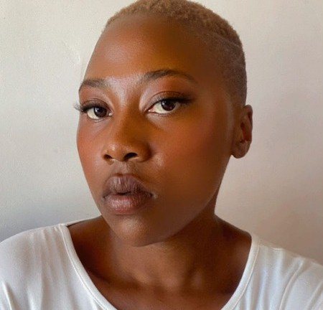

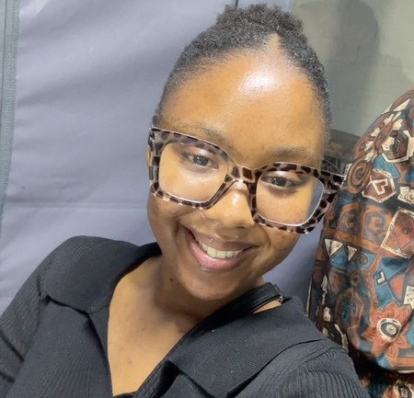

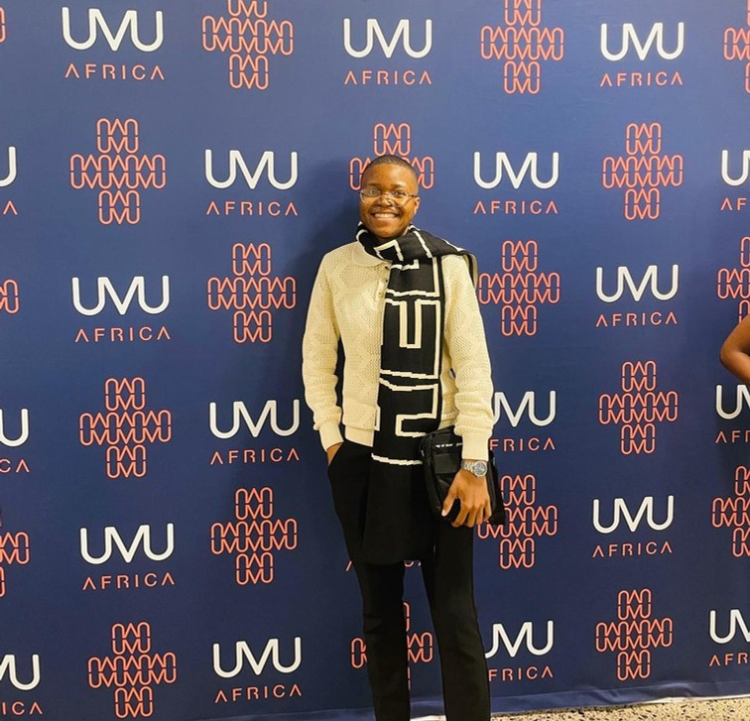

OUR TEAM
Siphokuhle Nyana
Presenter 1
Olwethu Mtwazi
Presenter 2
Mihle Nosilela
Presenter 3
Sinobawo Nkomo
Designer
Athini Ngquke
Designer
Information
Communication Technology

Slide 3
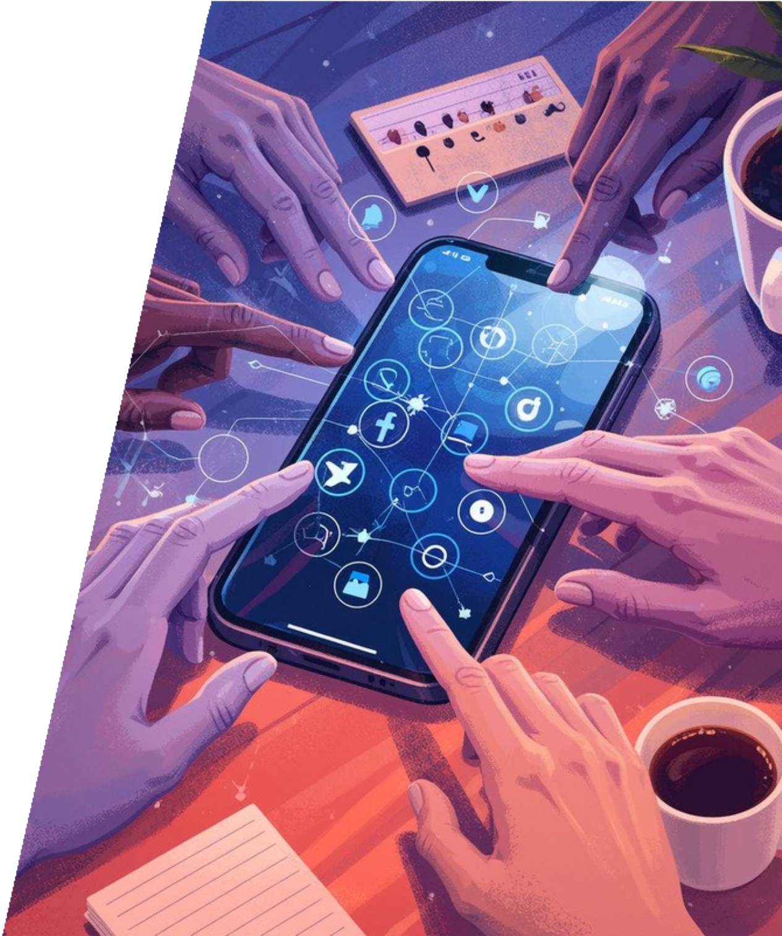
BUSINESS PROBLEM
Majority of students that are doing ICT are coming from disadvantaged backgrounds, and lack clothing items to wear on campus on a daily basis. The NSFAS living allowance they recieve on a monthly basis, must cover food, toiletries, and medication, making it to be very difficult for them to afford expensive clothing items that are sold on our local stores, on campus, and other online retail stores. Some of the online stores also requires them to pay for shipping fees that they cannot afford because of the cost of living.
CONSEQUENCES
Low self-esteem and social isolation.
Poor academic perfomance.
Low attendance rates
Information
Communication Technology

Slide 4
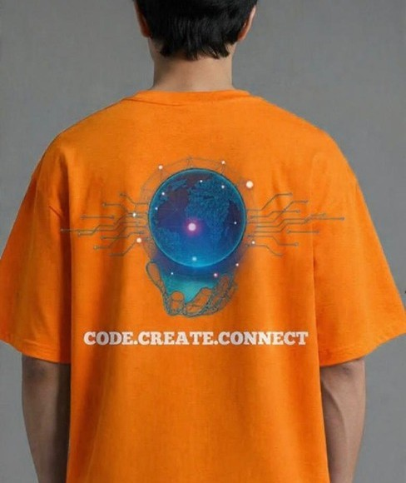
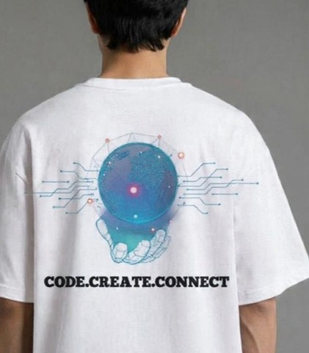
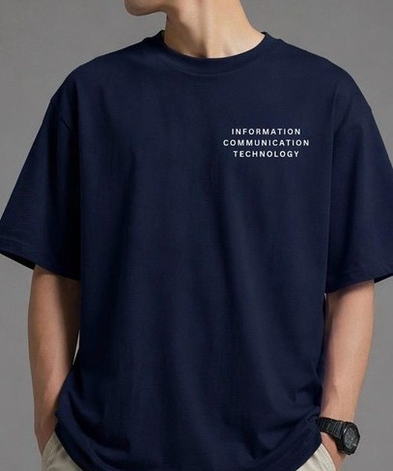
For R150
only!!
SOLUTION
Designing affordable, high-quality ICT Branded clothing items, starting with T-shirts.
Developing a web application for selling our clothing items with no delivery fee.
Information
Communication Technology

Slide 5

STATISTICS
A survey was passed to 28 student to check if they would like to wear them an if they would afford them.The results we received were used to check our revenue growth and return on investment
80%
Revenue Growth
10%
Return on Investment
75%
Customer Satisfaction
20%
Customer Acquisition Cost
Information
Communication Technology

Slide 6
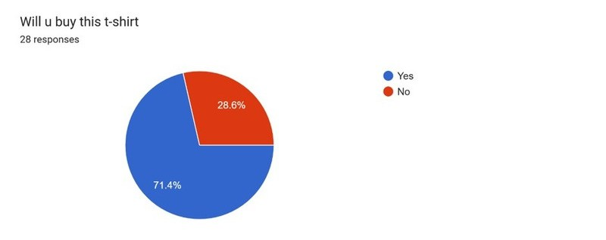
SURVEY RESULTS
Information
Communication Technology

Slide 7
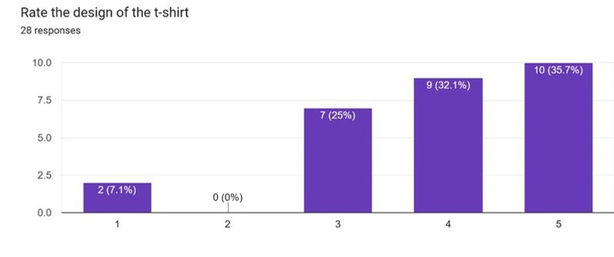
SURVEY RESULTS
Information
Communication Technology

Slide 8
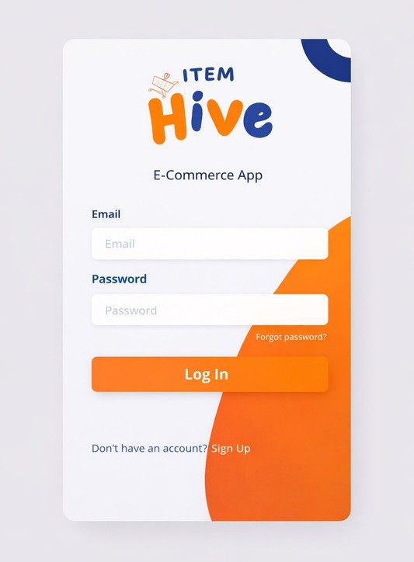
WEB APPLICATION
Information Communication Technology

Slide 9
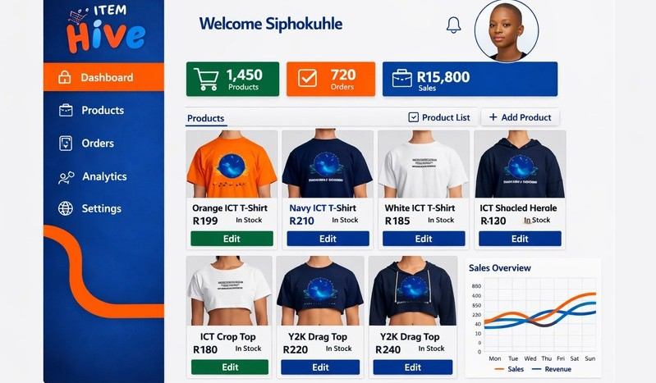
WEB APPLICATION
Information Communication Technology

Slide 10


CORPORATE COLORS
HEX CODE: #0097B2 CMYK:
100%,15%,0%,30% RGB:
0,196,204
HEX CODE: #FF751F CMYK:
0%,54%,88%,0% RGB
255,177,31
HEX CODE: #101D56 CMYK:
81%,66%,0%,66% RGB:
16,29,86
Information
Communication Technology

Slide 11
SECONDARY COLORS
HEX CODE: #CCCCCC CMYK: 0%,0%,%0,20% RGB 204,204,204
HEX CODE: #FFFFFF CMYK: 0%,0%,0%,0% RGB 255,255,255
HEX CODE: #000000 CMYK:
0%,0%,0%,100% RGB:
0,0,0
Information
Communication Technology

Slide 12



PROFESSIONAL LOGO USAGE
Information
Communication Technology

Slide 13



UNPROFESSIONAL LOGO USAGE
Information
Communication Technology

Slide 14





BRAND TYPOGRAPHY
Information Communication Technology
MAIN HEADINGS
Font name:Helvetica World Size:60
BODY CONTEXT
Font name:Source Sans Pro Size:21
SUB-HEADING
Name:Source Sans Size:23
ALTERNATIVE
Font name:Chunky Five Size:60

Slide 15


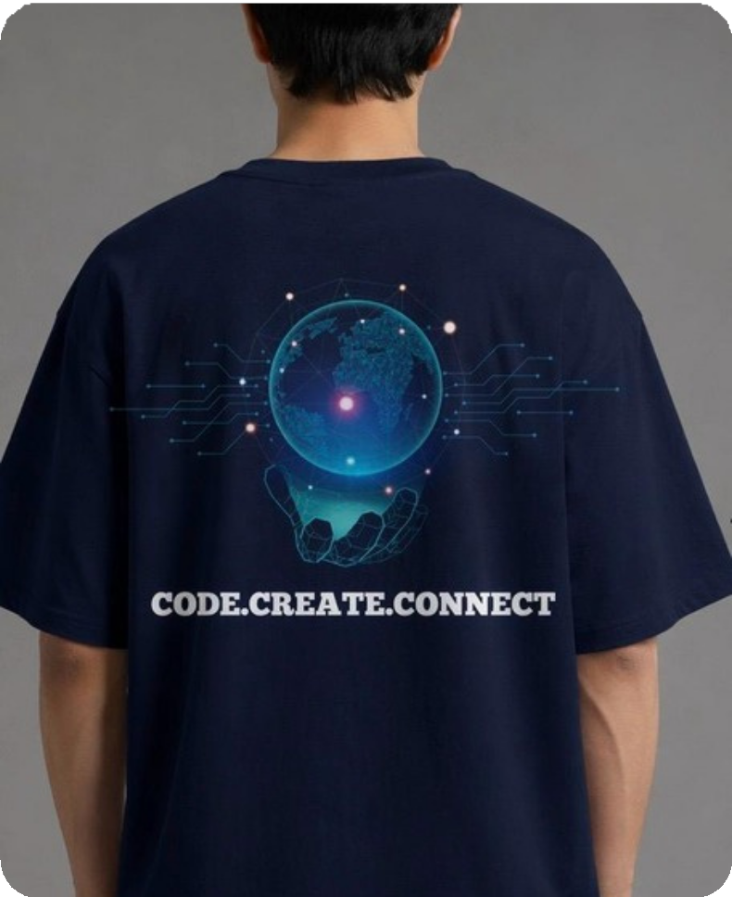
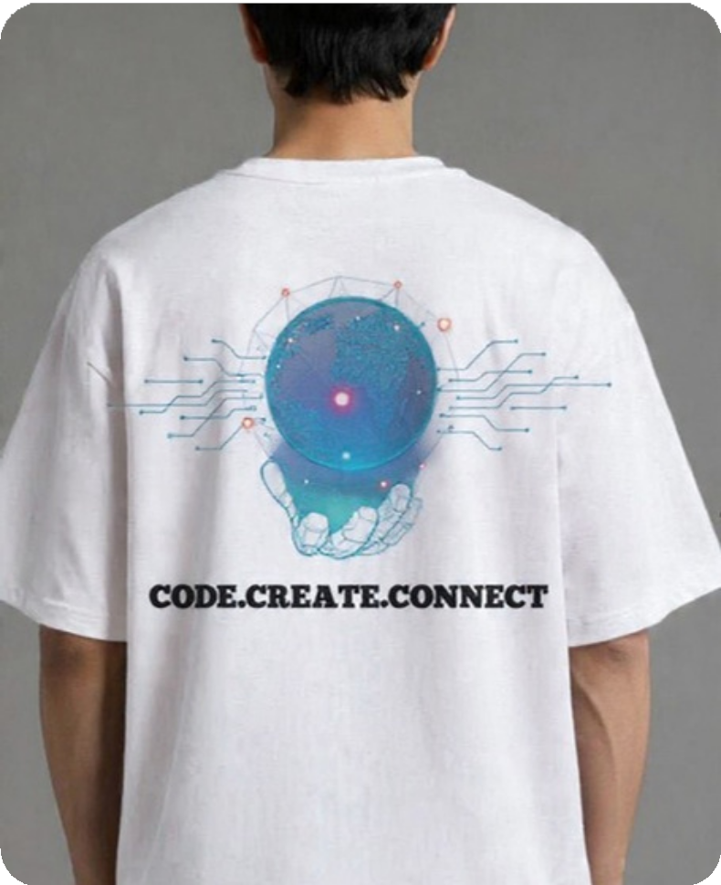
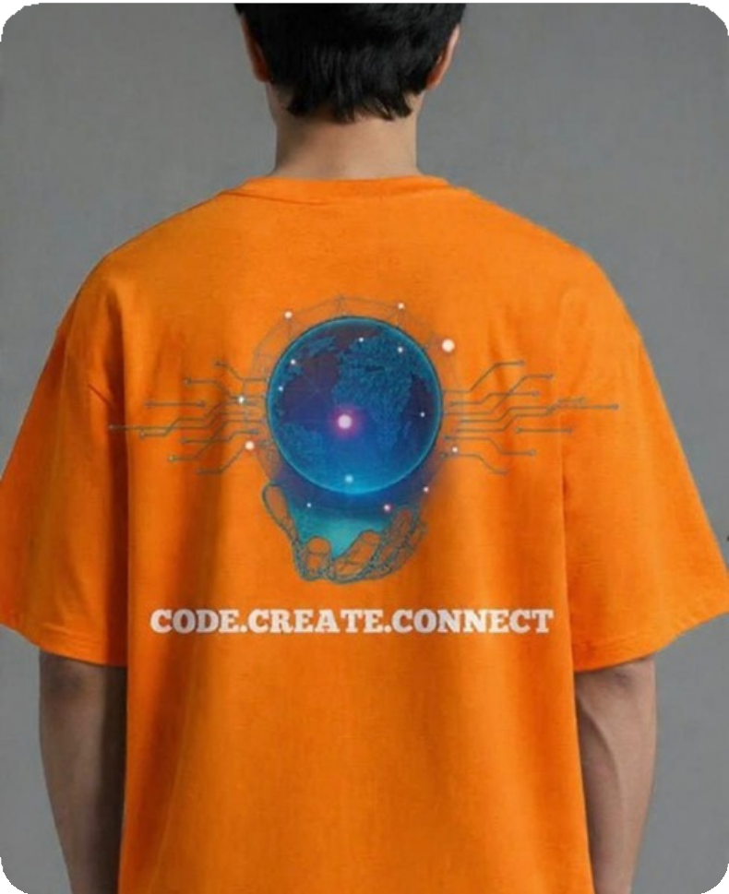
OUR PRODUCTS
Information Communication Technology
For R250
Only!!
For R200
Only!!
For R150
Only!!

Slide 16
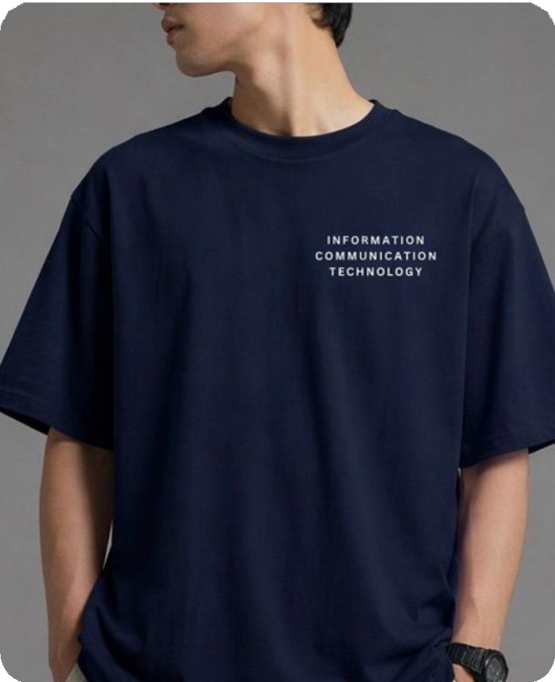
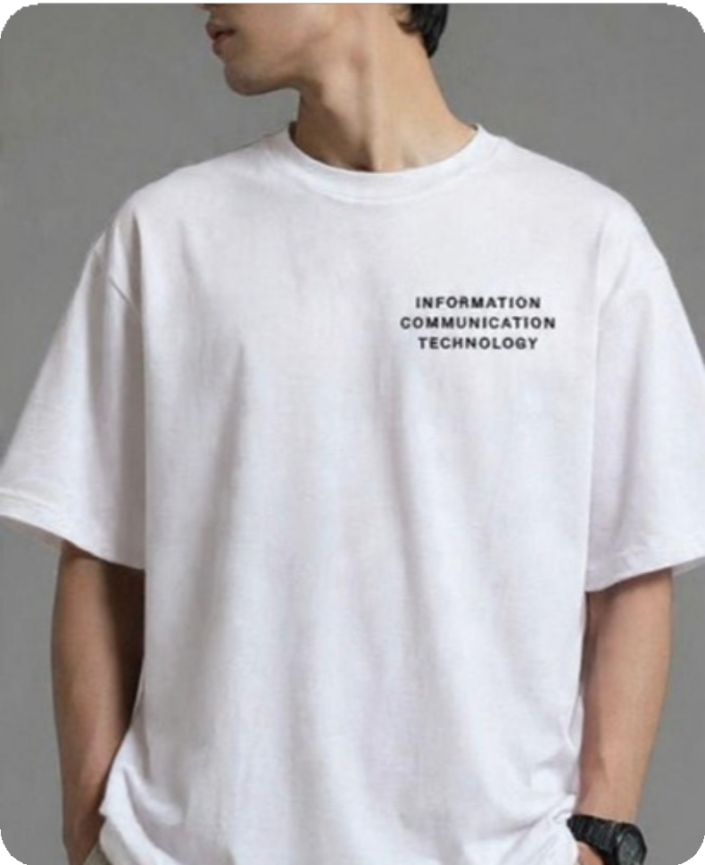
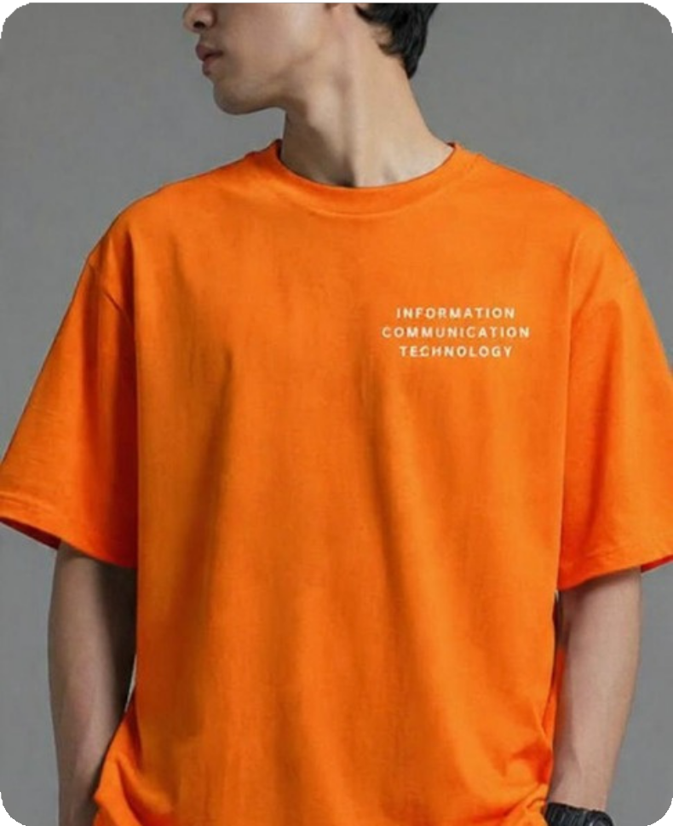
OUR PRODUCTS
Information Communication Technology
For R150
Only!!
For R250
Only!!
For R200
Only!!

Slide 17

Information Communication Technology

